Slide 1
Introduction to
Altera’s 28nm Portfolio
Technology Roadshow 2011

Slide 2
Agenda
Altera’s 28-nm Portfolio
Stratix V FPGAs: Build for Bandwidth
Arria V FPGAs: Balanced Performance, Power and Cost
Cyclone V FPGAs: Lowest System Cost and Power
Altera SoC FPGAs

Slide 3


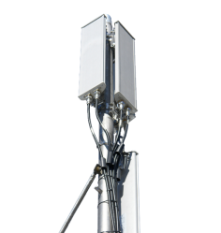
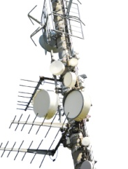
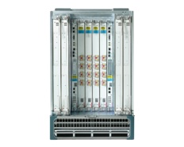
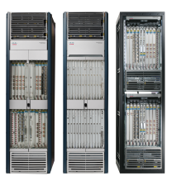
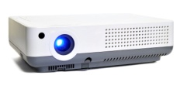


Introduction to Altera’s 28-nm FPGA Portfolio
Tailored to customers’ diverse design requirements
Offers industry’s most diverse product that meets expanding system needs in performance, power, and cost
Power
Power
Power
Costs
Performance
Handheld Projector
Desktop
Projector
Universal Mobile Telecommunication System (UMTS)
4G Long Term Evolution (LTE)
10G
100G
Notes:
Altera ‘s the 28nm FPGA portfolio meets customers diverse application needs with its tailored solution
With more products offered on 28 nm than any other node meets the diverse application requirements i.e. high performance applications need higher performance and low cost applications need lower cost.
5-10 years ago, FPGAs were able to address a limited number of applications from a cost, performance and power perspective. Over the past decade, these same applications have had extraordinary demands/requirements placed on them from a power, performance and cost perspective. All of these applications have increasing requirements of higher integration, performance and all for lower power.
BUILD 1
If you build the natural next progression in FPGAs Altera would hit the balance of power and cost well but would compromise performance on the high end and cost at the low end leaving a sub optimal solution for a vast majority of high performance and low cost applications. This natural progression would give enough higher performance for given power to address mid-range applications such as 4G LTE, studio switcher, 10G systems well. It would not meet the high performance needs for radar, 100G systems and or the low cost for handheld, industrial or display applications. This requires a different approach in order to address the diverse application requirements.
BUILD 2
Whether it be low cost or high performance, there is huge pressure to reduce system power. There are a few factors impacting that, system design cost by reducing cooling components and methods, cost of running a system for end consumers and reducing the overall carbon footprint to reduce global warming effects.
These conflicting requirements require semiconductor, system and solution companies to break away from tradition to better fit these application needs.

Slide 4
Process Choice for 28-nm Portfolio
Power
Power
Power
Power
TSMCs 28HP process and design optimizations
TSMC’s 28-nm Low- Power
(LP) Process and Design Optimizations
TSMC’s 28-nm High- Performance (HP) Process and Design Optimizations
TSMCs 28LP process and design optimizations
Cost
Cost
Speed
Speed
Cost
Speed
Cost
Speed
Cost
Speed
The optimal choice for addressing today’s power- and cost-constrained applications
Lowest absolute power
Highest bandwidth
28G transceivers at 200 mW
Lowest power in high-performance systems
Notes:
As we announced back in December of 2010, we have chosen to leverage two 28nm process options within our28nm portfolio. This approach enables Altera to better address customers diverse design requirements.
28LP
For our low-cost and mid-range product families, we are leveraging TSMC’s 28LP process. This selection provides us with the optimal choice for addressing today’s power and cost constrained applications. The 28LP process delivers the lowest absolute power and cost at 28nm. As a result, we are able to achieve 50% lower power than the previous process node.
28HP
For our high-end devices, we selected TSMC’s 28HP process. This process choice enables us to achieve the highest performance at the lowest power. 28HP delivers 35% higher performance than any other process option at 28 nm from TSMC and delivers 30% lower power compared to the previous generation. By selecting the 28HP process, we are capable of delivering 28 Gbps transceivers that operate at 200mW total power.

Slide 5
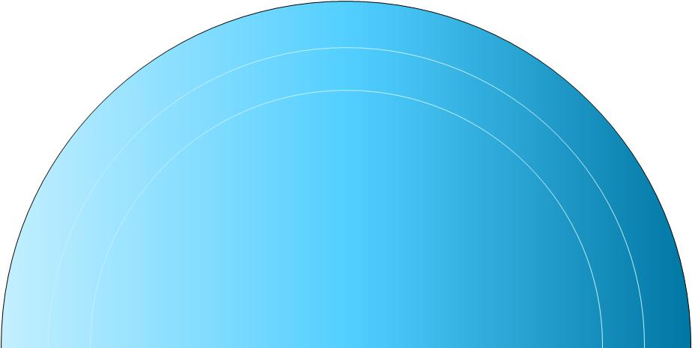
Transceivers that Span the Horizon
Data Rates
Protocols
Power
5G
>15
88 mW
10G
>30
135 mW
28G
>50
200 mW
600 Mbps
Pre-Emphasis and Equalization
Backplane
High
Performance
Low Cost
Base Module
(3G, 5G, 10G, 14G, 28G)
Transceiver
Altera’s 28-nm Transceiver Technology is Based on a Modular Architecture Leveraged Across the Entire Portfolio
Notes:
Altera building on the same successful transceiver technology built by the same team over the last 10+ years. This guarantees high quality and same architecture for best results across the portfolio. Since it is the same architecture customers can use same SW, IP across the portfolio and do not need to learn new architectures.
At 28 nm Altera developed a modular transceiver which gives the flexibility to use the same base architecture yet optimize transceivers for different applications. If an application such as I/O expansion requires 5Gbps transceivers no use burdening it with larger size 28 Gbps transceivers resulting in higher cost and power. Yet can get 28 Gbps performance for the absolute highest data rate for the lowest power. Using 10 x 10 Gbps transceivers costs more and consumes more power than using 4, 28 Gbps transceivers. It also allows to create a balanced transceiver in the middle to hit 10 Gbps in an optimal way.
A large number of protocols are supported by the transceivers.
Transceiver Protocols Supported: 3G-SDI, 10G-SDI, 10-Gbps Ethernet XAUI, ASI, Basic Mode, CEI-6G/SR/LR, CPRI, DDR-XAUI, DisplayPort, Fiber Channel, GbE, GPON, HiGig+, HiGig2, HyperTransport 3.0, IEEE 802.3ae 10GBASE-R, IEEE 802.3ae 10GBASE-KR, IEEE 802.3ae 40G, IEEE 802.3ae 100G, Interlaken, Interlaken (10G), JESD204A, OBSAI, OTU-2, OTU-3, OTU-4, PCI Express Gen1, PCI Express Gen2, PCI Express Gen3, QDR InfiniBand, QPI, SAS, SATA, SDI SD/HD, SerialLite II, Serial RapidIO, SFP+, SFI-4.2, SFI-5.1, SFI-5.2, SGMII, SONET OC-3/OC-12/OC-48, SONET OC-192, SPI-4.2, SPI-5.1, SPAUI, V-by-One, XFP

Slide 6
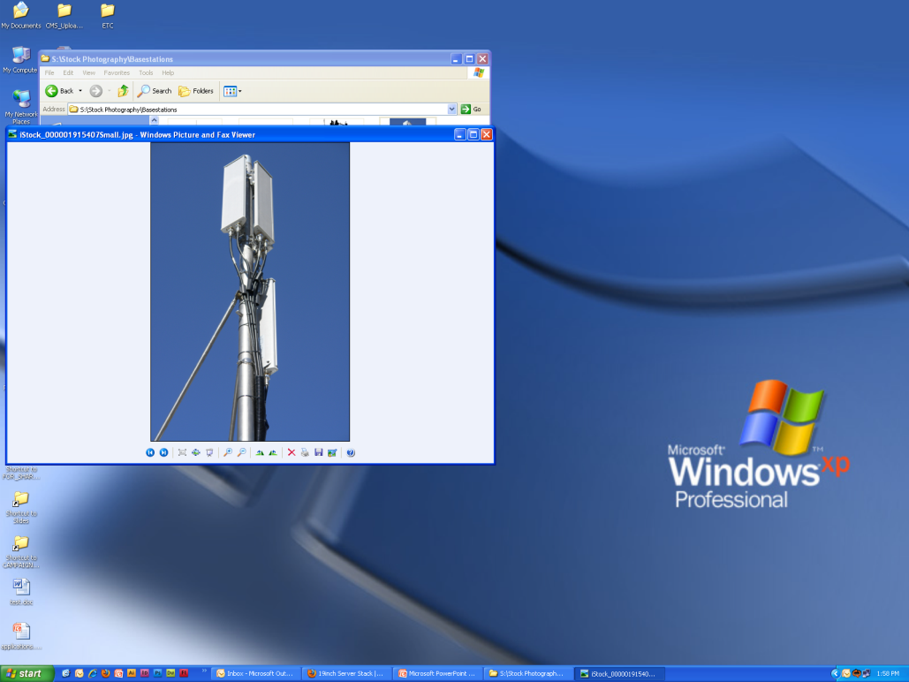
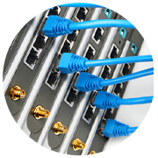
On-Chip Memory Architectures
M20K
M10K
Memory Logic Array Block (MLAB)
Remote Radio Unit
Requires More Ports for Efficient Buffering
100 GbE Line Card
Requires Raw Bit Density
All Applications
Require Small Buffers
Wireline
Wireless
Broadcast
Military
:
M10K Block | New M10K memory block enables high buffer performance More ports per silicon area
M20K Block | Built for high data performance More bits per silicon area
MLAB Block | 640 bits Shallow FIFOs Delay elements
Notes:
M20K blocks would provide the raw bandwidth but are not optimal for video buffers which would not use the full memory density.
In order to address buffering needs a separate memory block was architected to be smaller in bit density giving more ports
with increased efficiency i.e. no wastage of bits and more ports in a given die area. This works really well for FIR filters in wireless systems, video buffers in broadcast, consumer video applications. M20K addresses packet processing needs well were its about the ray memory density.
Even with M10K you can end up wasting over 90% of the block if it is used for small FIFOs and small buffers. To not tax the M10K and waste silicon area (hence cost) a separate MLAB has been designed with only 640 bits. This gives tremendous flexibility, high efficiency and low cost solution for FIFOs.
100G, packet processing systems would benefit from M20K.
3D TV, motor control, studio equipment would benefit from the M10K and higher number of ports.
All applications would benefit from small FIFOs implementation in the MLAB.

Slide 7

External Memory Support in Portfolio
Hard Memory Controller for Low-Cost Applications
(Mobile DDR, LPDDR2 and
400 MHz DDR3)
Hard Memory Controller for Mid-Range Applications
(533 MHz DDR3)
Soft Memory Controller for High-Bandwidth Applications
(1066 MHz DDR3,
RLDRAMIII and QDR II+)
Night-Vision Goggles
Video Switcher
40GbE/100GbE Switch
Demands Low Power and Low Latency in a Space-Constrained Application
Demands Low Latency and Fixed Functionality for Ease of Use
Demands the Highest Bandwidth with Maximum Flexibility
Notes:
Hard memory controller was designer for:
Low cost and power by not taxing the programmable logic
Reduce latency which fits embedded application needs extremely well
They do lack in flexibility provided by soft memory controllers but low cost systems use low cost memories which are well defined with DDR2, DDR3.
Hard Memory Controller is ideal for cost sensitive applications and there are two variants.
Low cost and power which supports low cost applications with DDR3 only up to 400 MHz and mobile DDR and LPDDR2 which are low power for handheld applications such as night vision goggles, POS, Software defined radios etc.
Low cost with the highest possible performance. Even though power is important it does not have to be the absolute lowest power for these applications and higher performance would fit well. This memory controller supports 533 MHz DDR3 which matches the target application requirements well. Increasing it any further would increase the cost and power of the solution and exceed the application needs. This is ideal for 10G/40G systems, video switchers etc.
High performance applications need the flexibility of:
Which memory type to use i.e. DDR3, RLDRAM III, QDRII+ etc.
What data width to use x16 or x72
These applications are not as cost sensitive and prefer flexibility
For high performance computing, 100G switch, studio equipment the flexibility and need to increase data width outweighs the cost.

Slide 8

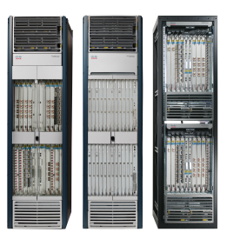



I/O in 28-nm Architecture Tailored to Applications
Low-Cost I/O Block Architecture
Supports 400-MHz DDR3
with 3.3 V@16 mA
Mid-Range I/O Block
Architecture
Supports 667-MHz* DDR3
and 1.25-Gbps LVDS
High-Performance I/O Block Architecture
Supports 1066-MHz DDR3 DIMM and 1.4-Gbps LVDS
Handheld Projector
Remote Radio Unit
100G
Broadcast
Equipment
40GbE/100GbE Switch
Wide Dynamic Range (WDR)
Surveillance Camera
Notes:
* Support 667MHz DDR3 interface by soft IP core
High performance I/O blocks are ubiquitous and support high data rates for memory and LVDS. These are ideal for high end wireless, radar, 100G systems.
Carrying these I/O to mid-range applications such as remote radio units and studio switchers would add a cost burden to the chip. In order address the cost needs, Altera designed the I/Os for these applications to meet 533 MHz DDR3 and 1.25 Gbps LVDS exactly what the applications need. There is a set of industrial applications that requires 3.3V I/Os with 16 mA drive strengths. Instead of adding that to the other set of I/Os and increasing the buffer size there, a separate I/O architecture was designed to address these applications. Since these applications are cost sensitive, this feature was only added to the low cost I/O block.

Slide 9
System IP Tailored to Diverse Application Requirements
Developing system IP in- house and targeting on focused applications
Hardening system IP in devices to hit cost, power, and performance requirements for focused applications
This is just the beginning…
PCIe Gen3 x8
EHB
Bandwidth
Hard Memory Controller
PCIe Gen2 x4*
Hard Memory Controller
PCIe Gen2 x4
Low Cost
Mid Range
High
Performance
Notes:
* Mid-range to support PCIe x8 by 3rd party soft core.
In the area of System IP, we continue to look at hardening specific areas of our 28nm portfolio in an effort to achieve lower power and higher performance in our devices. We as a company are committing resources to develop different system IPs in house. By hardening specific functions in our devices, we can effectively target a much broader group of applications. In the low cost and mid-range applications, we have hardened functions such as Triple Speed Ethernet and memory controllers in order to lower power and cost. While on the high-end, protocols such as Interlaken, 40G/100G and 100GbE have been hardened in order to effectively target the highest performance, highest bandwidth applications.
The PCI Express hard IP block embeds the PCI Express protocol stack into the 28nm portfolio. Diversifying our support of PCIe across the portfolio enables us to again effectively address the requirements of a broad selection of applications. Our PCIe support ranges from PCIe Gen2 x1 at the low end to PCIe Gen3 x8 at the high end.
However, we are judicious and strategic with the capabilities we harden in our devices. We realize that hardening certain functions for one customer might incur a cost penalty for other customers. So we think strategically about what capabilities to harden that will benefit the majority of our customer base.
And this is just the beginning. We are continuing to look at other areas in our devices to harden.

Slide 10




Broadest 28-nm Product Portfolio
28-nm Product Portfolio
E, GX, GT
GX, GT
E, GX, GS, GT
E, GX, GS
More Products than Any Other Prior Node
Notes:
10
10
As you can see, we have really delivered quite a comprehensive product portfolio at 28nm. Through diversification within the portfolio, we are able to deliver devices that are tailored to customers diverse design requirements – from the low end applications that require the lowest possible power and cost, to the mid-range that require balanced performance, power and costs, to the high-end, that requires the highest performance and highest bandwidth.
We are delivering at 28nm more products than any other prior node to meet expanding system needs.

Slide 11
Stratix V FPGAs:
Built for Bandwidth
Notes:
11

Slide 12
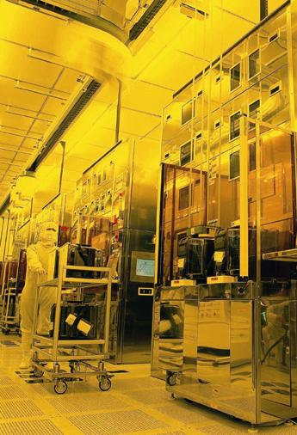
Stratix V FPGA Family on 28-nm Process
Stratix V FPGAs are built on TSMC’s high-performance 28-nm HKMG process
  Optimized for low power
Ideal choice for devices used in next-generation, high-bandwidth systems
  35% higher performance than alternative process options
  30% lower total power versus previous generations
  Enables fastest and most power-efficient transceivers

Slide 13


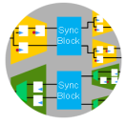
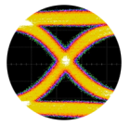

Stratix V FPGAs – Built for Bandwidth
Highest bandwidth
  66 transceivers with14.1 Gbps transceivers
  Devices with 28-Gbps transceivers
  6 x72 bit 1066-MHz DDR3 interfaces
Unprecedented level of integration
  Embedded HardCopy Blocks supporting PCI Express Gen3
  Variable Precision DSP Block optimized for
  for FIR and FFT applications
  Enhanced logic fabric with 1M LEs, 52 Mb RAM, and 3926 18x18 multipliers
Ultimate flexibility
  Fine-grain and easy-to-use partial reconfiguration
  Configuration via Protocol Using PCIe
50% higher system performance and 30% lower total power
Highest Bandwidth
Hard IP and Flexibility
IP Solutions and
Ecosystem
IP

Slide 14
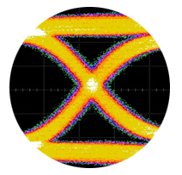
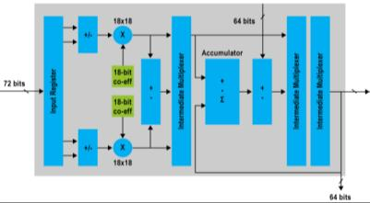
Stratix V Device Family Variants
Stratix V GT variant
  28 Gbps for high-performance,
  ultra-high bandwidth applications
Stratix V GX variant
  Up to 66 transceivers at 14.1 Gbps for high performance, high bandwidth
Stratix V GS variant
  Optimized for high-performance,
  high-precision DSP applications with transceivers up to 14.1 Gbps
Stratix V E variant
  For highest density, high-performance applications
28-Gbps
Transceivers
Variable-Precision
DSP Block

Slide 15
Arria V FPGAs:
Balanced Performance, Power and Cost
Notes:
15

Slide 16



Arria V FPGAs
Lowest power 6G and 10G FPGAs
Adaptive logic modules (ALMs)
Variable-precision digital signal processing (DSP) blocks
M10K embedded memory blocks
Distributed memory logic array blocks (MLABs)
PCI Express® (PCIe®) Gen1 and Gen2
Hard multiport memory controller
With 6G transceivers
With 10G transceivers

Slide 17
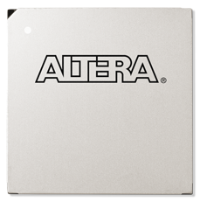


Arria V FPGAs: Balanced Power, Performance, and Cost
Lowest power mid-range FPGAs
  Built on 28-nm Low-Power (28LP) process
  Lowest static power in class
  <100 mW per transceiver channel at 6G, <140 mW at 10G
  40% lower power than previous generation
Innovative features reduce system power and cost
  Up to 36 x 6G backplane-capable low-power transceivers
  Up to 8 x 10G chip-to-chip transceivers
  Hard intellectual property (IP) for:
    Multiport memory controller
    PCIe Gen2
  Variable-precision DSP blocks
  Partial reconfiguration
Simplification reduces system power and cost
  Only three power rails to simplify power distribution
  Thermal Composite Flip-Chip BGA package options for better thermal characteristics
<100 mW at 6G
<140 mW at 10G
Lowest Power and System Cost for Mid-Range Applications
17
Notes:
17

Slide 18
Target Applications (1/2)
Industry | Applications
Wireless communications | Remote radio heads
 | RF cards and channel cards
 | Mobile backhaul
Wireline communications | 20G/40G bridging and switching
 | 20G packet processing
 | Gigabit-capable passive optical network (GPON)
Broadcast | Digital modulation equipment (including EdgeQAM and satellite and terrestrial broadcast)
 | Pro audio/visual (A/V) switchers
 | Video conferencing
 | PCIe capture and cameras
Computer and storage | Custom storage
 | Flash memory cache
 | Plug-in cards
Notes:
18

Slide 19
Target Applications (2/2)
Industry | Applications
Test and medical | Ultrasound
 | CT scanning
 | Other diagnostic imaging
 | Portable and wireless tests
Military | Guidance control
 | Tactical electronic warfare
 | Custom storage
 | Electro-optical/infrared (EO/IR) system
Industrial and consumer | Human-machine interface
 | I/O companion
 | High-end display
19
Notes:
19

Slide 20
Cyclone V FPGAs:
Lowest System Cost and Power
Notes:
20

Slide 21
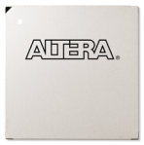

Cyclone V FPGA Family: An Introduction
Opening Up Design Possibilities
E Variant
Lowest cost and power
GX Variant
3G transceivers
GT Variant
5G transceivers
Optimized for lowest system cost and power for a wide spectrum of general logic and DSP applications
Optimized for lowest cost and power for 614 Mbps to 3.125 Gbps transceiver applications
FPGA industry’s lowest cost and power for 5.0 G transceiver applications

Slide 22
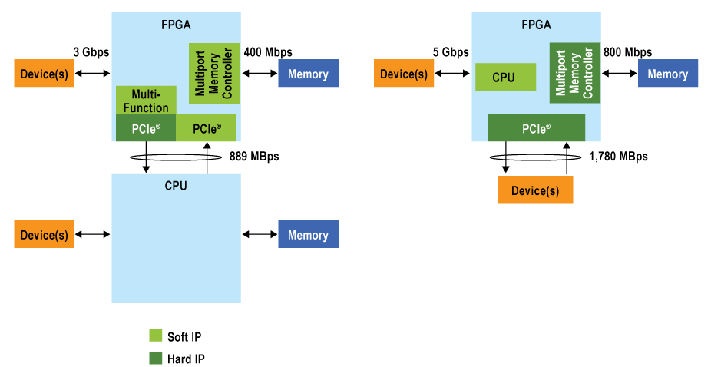
System Cost Reduction via Integration
Before
After
Lower Power and
More Bandwidth
Notes:
Lower cost
10-40K fewer LEs → smaller FPGA
Fewer devices on board BOM
Reduced PCB size, complexity, and layer count → cheaper PCB
Lower power
40% lower total power
More bandwidth

Slide 23
Cyclone V FPGAs:
Lowest System Cost and Power
Lowest system cost
  Increased use of hard IP blocks
  Only two voltage rails for core and transceivers
  Configuration via Protocol (CvP)
  Wirebond packaging
Lowest system power
  40% lower total power than previous generation
  28-nm LP process
  Hard IP blocks
High Functionality
  300K logic elements
  12 Mbits of block memory
  390 variable precision DSP blocks
  Up to two PCIe and two Memory Controller Blocks
  Up to twelve 5.0 Gbs transceiver I/O channels
    Hard IP:
    * 5-Gbps transceiver I/Os
    * PCIe Gen 2 multi-function
    * Multi-port memory controller
    * Variable precision DSP
Notes:
Lower power
20% lower static power
60% lower dynamic power
40% lower transceiver power
Higher integration with hard IP
Up to 12 integrated transceivers
PCIe Gen2 x1, x2 lanes or PCIe Gen1 x1, x2, x4 lanes, rootport and endpoint with multifunction support
Hard memory controller for DDR3, DDR2, LPDDR2, LPDDR
Enhanced architecture
8-LUT + 4 registers logic fabric
Variable precision DSP blocks for flexible precision, faster performance and lower logic utilization
Support for faster, lower cost configuration

Slide 24
Altera SoC FPGAs

Slide 25
Key Requirements Driving Industry Trend
Performance improvement and cost saving
Low power to meet thermal requirement
Bandwidth improvement
Leverage design resource and ecosystem
Notes:
Design engineer is facing challenge of performance improvement and cost saving, lower power to meet thermal requirement, improve bandwidth, and leverage design resource and ecosystem to shorten time to market. These devices have reached a tipping point driven by key economic, technical, and market forces, The era of SoC FPGAs has begun. Numerous vendors have already announced or are shipping.

Slide 26
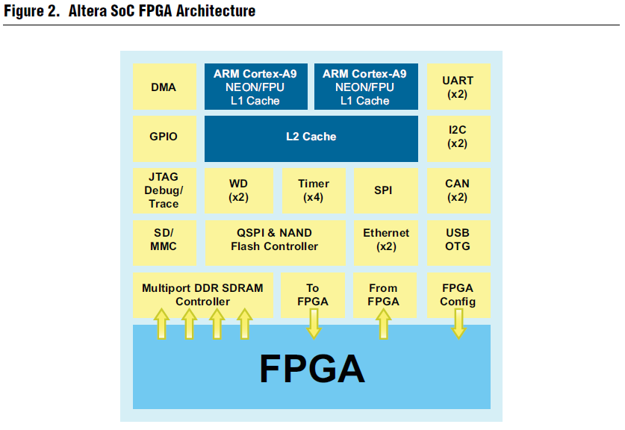
Notes:
Altera's newest SoC FPGA will contain an advanced processor block based on the ARM Cortex-A9MP core, The Altera SoC FPGA architecture will feature a broad array of hardened IP within the ARM-Cortex A9 subsystem, as well as high-performance mutiport memory controllers for maximum memory bandwidth. High bandwidth, low latency interconnects between the FPGA and the CPU subsystem will allow for high-performance applications and efficient FPGA hardware acceleration. Advanced internal switch fabrics will support efficient data throughput, as well as highly productive in-system observability and debugging.

Slide 27
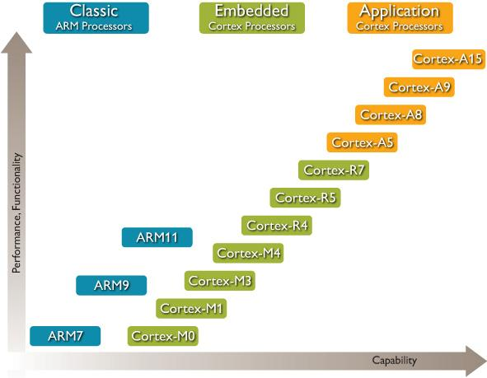
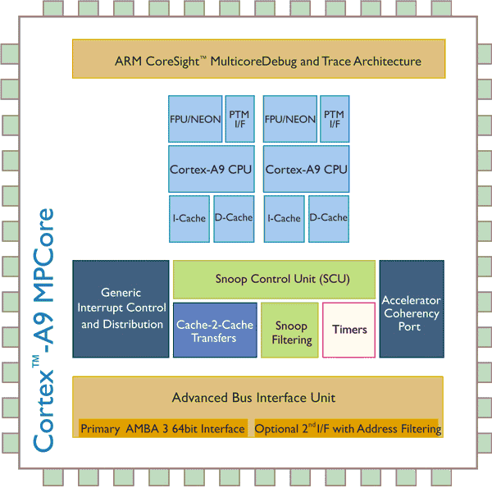
ARM Cortex-A9 Core
Dual-Issue Superscaler pipeline
Out-of-Order dispatch and execution
2.5Dhrystone MIPS/MHz
Single, and double-precision Floating-Point Unit
NEON Media Processing Engine (SIMD) for media and signal processing acceleration
Thumb-2 for up to 30% reduction in memory footprint
Coherent L1 caches
Memory coherency maintained between processors and FPGA
Notes:
The ARM Cortex-A9MP core has a Dual-issue superscalar CPU architecture which executes two instruction during a clock cycle by simultaneously dispatching two instructions. Also to improve the efficiency, ARM A9 also implements out of order execution which the processor executes instructions in an order governed by the availability of input data, rather than by their original order in a program. With Dual-issue superscaler and out-of-order dispatch and execution, a single ARM Cortex-A9MP core can achieve 2.5DMIPS/MHz
Also the ARM Cortex-A9MP core will have double precision floating point unit. NEON media processing engine for media and signal processing accelerate.
ARM A9 supports Thumb-2 16bit instruction set for up to 30% reduction in memory footpoint
To improve performance of the processor, coherent L1 caches will be implemented.

Slide 28

Leveraging the ARM ecosystem
Notes:
ARM ecosystem is the industry’s largest network. It includes software and training providers, design support partners, and silicon partners which enabling to access a huge range of ARM resource and complete solution. This will accelerate you from design to manufacture and releasing.

Slide 29






Qsys System Integration Platform
High-performance Interconnect
Hierarchy
System Verification
Based on Network-on-Chip architecture
Industry-standard Interfaces
Design Reuse
 | AXI3, AXI4
 | Avalon interfaces
Package as IP
Design
System
Add to
Library
(design reuse)
Qsys is Altera’s design environment for
  Deployment of IP
  Deployment of reference designs and example designs
  Development platform for Altera custom solutions
  Design platform for customers to quickly create system designs
Notes:
When combined with Qsys, the Quartus II software, and ARM Connected Community software tools, this device will represent a highly cost-effective system design option that leverages standard tool flows for maximum productivity, and offers significant new development and verification possibilities.
In addition to Altera's traditional Avalon® Memory-Mapped (Avalon-MM) interface and data path bus interface specification, Qsys will also support the ARM AXI™ standard, which will allow an automated “mix and match” approach to integrating Avalon-based IP with AXI-based IP. Qsys allows a fast, intuitive design experience that supports easy design reuse and in-system verification across the entire common platform for ARM

Slide 31
Appendix: Product Table
Notes:
31

Slide 32
Stratix V GX / GT Family Plan
 | Device | Interconnect |  |  | Hard IP |  | Core Fabric
 |  | Transceivers (14.1G, 28G) | GPIO | 72-bit DDR3 | x8 PCIe Gen3 | 40G/100G Ethernet | LEs | Memory M20K (Mbits/#Blocks) | 18x18 Mults | fPLLs
Stratix V GT FPGA | 5SGTC5 | 32, 4 | 600 | 4 | 1 | No | 425K | 45 / 2304 | 512 | 24
 | 5SGTC7 | 32, 4 | 600 | 4 | 1 | No | 622K | 50 / 2560 | 512 | 24
Stratix V GX FPGA | 5SGXA3 | 36, 0 | 696 | 4 | 1 or 2 | No | 340K | 30 / 1550 | 512 | 24
 | 5SGXA4 | 36, 0 | 696 | 4 | 1 or 2 | No | 420K | 37 / 1900 | 512 | 24
 | 5SGXA5 | 48, 0 | 840 | 6 | 1,2 or 4 | No | 490K | 45 / 2304 | 512 | 28
 | 5SGXA7 | 48, 0 | 840 | 6 | 1,2 or 4 | No | 622K | 50 / 2560 | 512 | 28
 | 5SGXA9 | 48, 0 | 840 | 6 | 1,2 or 4 | No | 840K | 52 / 2640 | 704 | 28
 | 5SGXAB | 48, 0 | 840 | 6 | 1,2 or 4 | No | 950K | 52 / 2640 | 704 | 28
 | 5SGXB5 | 66, 0 | 600 | 4 | 1 or 4 | No | 490K | 41 / 2100 | 798 | 24
 | 5SGXB6 | 66, 0 | 600 | 4 | 1 or 4 | No | 597K | 52 / 2660 | 798 | 24
32
Notes:
32
32
32
32

Slide 33
Stratix V GS / E Family Plan
 | Device | Interconnect |  |  | Hard IP |  | Core Fabric
 |  | Transceivers (14.1G, 28G) | GPIO | 72-bit DDR3 | x8 PCIe Gen3 | 40G/100G Ethernet | LEs | Memory M20K (Mbits/#Blocks) | 18x18 Mults | fPLLs
Stratix V GS FPGA | 5SGSD3 | 24, 0 | 432 | 2 | 1 | No | 236K | 13 / 688 | 1200 | 20
 | 5SGSD4 | 36, 0 | 696 | 4 | 1 | No | 360K | 18 / 957 | 2088 | 20
 | 5SGSD5 | 36, 0 | 696 | 4 | 1 | No | 462K | 40 / 1950 | 2996 | 24
 | 5SGSD6 | 48, 0 | 840 | 6 | 1 | No | 583K | 45 / 2320 | 3550 | 28
 | 5SGSD8 | 48, 0 | 840 | 6 | 1 | No | 695K | 50 / 2567 | 3926 | 28
Stratix V E FPGA | 5SEE9 | 0, 0 | 840 | 6 | No | No | 840K | 52 / 2640 | 704 | 28
 | 5SEEB | 0, 0 | 840 | 6 | No | No | 950K | 52 / 2640 | 704 | 28
33
Notes:
33
33
33
33

Slide 34
Stratix V GX/GS Package Plan – WW22 Update
Device | F780 (29 mm) | F1152 (35 mm) | F1152 (35 mm) | F1517 (40 mm) | F1517 (40 mm) | F1760 (43 mm) | F1932 (45 mm)
5SGSD3 | 360, 90, 12^{H} | 432, 108, 24
5SGSD4 | 360, 90, 12^{H} | 432, 108, 24 |  | 696, 174, 36
5SGSD5 |  | 552, 138, 24 |  | 696, 174, 36
5SGSD6 |  |  |  | 696, 174, 36^{H} |  |  | 840, 210, 48
5SGSD8 |  |  |  | 696, 174, 36^{H} |  |  | 840, 210, 48
5SGXA3 |  | 552, 138, 24 | 432, 108, 36^{H} | 696, 174, 36
5SGXA4 |  | 552, 138, 24 | 432, 108, 36^{H} | 696, 174, 36
5SGXA5 |  | 552, 138, 24 | 432, 108, 36 | 696, 174, 36 | 600, 150, 48 |  | 840, 210, 48
5SGXA7 |  | 552, 138, 24 | 432, 108, 36 | 696, 174, 36 | 600, 150, 48 |  | 840, 210, 48
5SGXA9 |  |  |  | 696, 174, 36^{H} |  |  | 840, 210, 48
5SGXAB |  |  |  | 696, 174, 36^{H} |  |  | 840, 210, 48
5SGXB5 |  |  |  | 432, 108, 66 |  | 600,150, 66
5SGXB6 |  |  |  | 432, 108, 66 |  | 600,150, 66
Stratix V GS FPGA
Stratix V GX FPGA
Notes
Legend: GPIO (single-ended), LVDS (full duplex), XCVR (full duplex)
Flip Chip ball-grid array (BGA) with 1.0-mm pitch
^{H} :Hybrid package
Pin migration across devices within family member
Pin Migration Across Family Members

Slide 35
Stratix V GT/E Device Package Plan
Device | F780 (29 mm) | F1152 (35 mm) | F1152 (35 mm) | F1517 (40 mm) | F1517 (40 mm) | F1932 (45 mm)
_____Stratix V GX FPGA
5SGXA5 |  | 552, 138, 24 | 444, 111, 36 | 696, 174, 36 | 600, 150, 48 | 840, 210, 48
5SGXA7 |  | 552, 138, 24 | 444, 111, 36 | 696, 174, 36 | 600, 150, 48 | 840, 210, 48
_____Stratix V GT FPGA
5SGTC5 |  |  |  |  | 600, 150, 36*
5SGTC7 |  |  |  |  | 600, 150, 36*
_____Stratix V E FPGA
5SEE9 |  |  |  | 696, 174, 0^{H} |  | 840, 210, 0
5SEEB |  |  |  | 696, 174, 0^{H} |  | 840, 210, 0
Notes: Flip Chip ball-grid array (BGA) with 1.0-mm pitch
Notes
Legend: GPIO (single-ended), LVDS (full duplex), XCVR (full duplex)
Flip Chip ball-grid array (BGA) with 1.0-mm pitch
^{H} :Hybrid package
*GX-GT migration. Unused transceiver channels connected to power/ground
Pin migration across devices within family member
Pin Migration Across Family Members
Notes:
35
35
35

Slide 36
Arria V FPGA Family Plan
 | Device | Core Fabric |  |  |  |  |  | Interconnect |  |  | Hard IP
 |  | LEs (K) | M10K Memory (Kb) | MLABs (Kb) | DSP Blocks | 18x18 Mults | fPLLs | Maximum Transceivers (6.375G, 10G) | Maximum GPIO | Maximum LVDS (1.25 Gbps) | Maximum x4 PCIe Gen2 Blocks | Maximum Hard Memory Controllers
Arria V GT (1) | 5AGTD3 | 362 | 17,260 | 2,098 | 1,045 | 2,090 | 12 | 12-24, 0-4 | 704 | 336 | 1 | 1
 | 5AGTD5 | 500 | 23,780 | 2,943 | 1,139 | 2,278 | 16 | 12-36, 0-8 | 688 | 328 | 1 | 4
Arria V GX | 5AGXA1 | 75 | 8,000 | 463 | 240 | 480 | 10 | 12, 0 | 480 | 148 | 1 | 2
 | 5AGXA3 | 152 | 10,400 | 893 | 396 | 792 | 10 | 12, 0 | 480 | 148 | 1 | 2
 | 5AGXA5 | 190 | 11,800 | 1,173 | 600 | 1,200 | 12 | 24, 0 | 544 | 256 | 2 | 4
 | 5AGXA7 | 242 | 13,680 | 1,448 | 800 | 1,600 | 12 | 24, 0 | 544 | 256 | 2 | 4
 | 5AGXB1 | 300 | 15,100 | 1,852 | 920 | 1,840 | 12 | 24, 0 | 704 | 336 | 2 | 4
 | 5AGXB3 | 362 | 17,280 | 2,098 | 1,045 | 2,090 | 12 | 24, 0 | 704 | 336 | 2 | 4
 | 5AGXB5 | 420 | 20,540 | 2,532 | 1,092 | 2,184 | 16 | 36, 0 | 688 | 328 | 2 | 4
 | 5AGXB7 | 500 | 23,800 | 2,943 | 1,139 | 2,278 | 16 | 36, 0 | 688 | 328 | 2 | 4
Note: Preliminary and subject to change
(1): For every 10G channel not used for data rates above 6.375 Gbps, an additional three 6-Gbps channels are available.

Slide 37
Arria V FPGA Package Plan
 | Device | F672 (27 mm) | F896 (31 mm) | F1152 (35 mm) | F1517 (40 mm)
Arria V GX | 5AGXA1 | 336, 9, 0 | 480, 12, 0
 | 5AGXA3 | 336, 9, 0 | 480, 12, 0
 | 5AGXA5 | 288, 9, 0 | 384, 18, 0 | 544, 24, 0
 | 5AGXA7 | 288, 9, 0 | 384, 18, 0 | 544, 24, 0
 | 5AGXB1 |  | 384, 18, 0 | 544, 24, 0 | 704, 24, 0
 | 5AGXB3 |  | 384, 18, 0 | 544, 24, 0 | 704, 24, 0
 | 5AGXB5 |  |  | 528, 24, 0 | 704, 36, 0
 | 5AGXB7 |  |  | 528, 24, 0 | 704, 36, 0
Arria V GT (1) | 5AGTD3 |  | 384, 12-18, 0-2 | 544, 12-24, 0-4 | 704, 12-24, 0-4
 | 5AGTD5 |  |  | 528, 12-24, 0-4 | 688, 12-36, 0-8
GPIO, Maximum 6G Transceivers, Maximum 10G Transceivers
Pin Migration
Notes:
“F” indicates ball-grid array (BGA) with 1.0-mm pitch
Supports RoHS-compliant packaging, leaded upon request
Preliminary and subject to change
(1) For every 10G channel not used for data rates above 6.375 Gbps, an additional three 6-Gbps channels are available

Slide 38
Preliminary Cyclone V Family Plan
Family | Device | Core Fabric |  |  |  |  |  |  | Interconnect |  |  | Hard IP
 |  | KLEs | # Blocks | Block Memory (Kb) | MLAB (Kb) | DSP Blocks | 18x18 Mults | PLLs | XCVRs (3G, 5G) | GPIO | LVDS Pairs | PCIe blocks | Memory Controllers
Cyclone V E | 5CEA2 | 25 | 152 | 1,520 | 147 | 39 | 78 | 4 | - | 300 | 48 | - | 0,1
 | 5CEA5 | 48 | 305 | 3,050 | 283 | 78 | 156 | 4 | - | 300 | 100 | - | 0,1
 | 5CEA8 | 75 | 451 | 4,510 | 442 | 132 | 264 | 4 | - | 360 | 100 | - | 0,2
 | 5CEB5 | 150 | 602 | 6,020 | 884 | 220 | 440 | 4 | - | 488 | 122 | - | 0,2
 | 5CEB9 | 300 | 1,246 | 12,460 | 1,769 | 406 | 812 | 4 | - | 488 | 122 | - | 0,2
Cyclone V GX | 5CGXC3 | 25 | 117 | 1,170 | 147 | 40 | 80 | 5 | 3, 0 | 194 | 48 | 0,1 | 0,1
 | 5CGXC4 | 50 | 285 | 2,850 | 295 | 70 | 140 | 6 | 6, 0 | 360 | 100 | 0,1 | 0,2
 | 5CGXC5 | 75 | 451 | 4,510 | 442 | 132 | 264 | 6 | 6, 0 | 360 | 100 | 0,1 | 0,2
 | 5CGXC7 | 150 | 602 | 6,020 | 884 | 220 | 440 | 7 | 9, 0 | 488 | 122 | 0,1 | 0,2
 | 5CGXC9 | 300 | 1,246 | 12,460 | 1,769 | 406 | 812 | 8 | 12, 0 | 688 | 122 | 0,1 | 0,2
Cyclone V GT | 5CGTD3 | 75 | 451 | 4,510 | 442 | 132 | 264 | 6 | 0, 6 | 360 | 100 | 2 | 2
 | 5CGTD5 | 150 | 602 | 6,020 | 884 | 220 | 440 | 7 | 0, 9 | 488 | 122 | 2 | 2
 | 5CGTD8 | 300 | 1,246 | 12,460 | 1,769 | 406 | 812 | 8 | 0, 12 | 688 | 122 | 2 | 2
Notes:
For each DSP block you can natively support 3x(9X9), 2x(18x18), or single 27 x 27 multiplier.
PLL counts include 4 general purpose PLLs and one PLL per triplet transceiver block. Transceivers are similar to Cyclone IV GX architecture.

Slide 39
Preliminary Cyclone V Package Plan
Family | Device | LE | E144 22x22 | F256 17x17 | F324 19x19 | U484 19x19 | F484 23x23 | F672 25x 25 | F896 31 x 31 | F1152 35 x 35
Cyclone V E | 5CEA2 | 25K | 90 | 140 | - | 300 | 300 | - | - | -
 | 5CEA5 | 48K | 90 | 140 | - | 300 | 300 | - | - | -
 | 5CEA8 | 75K | - | - | - | 260 | 260 | 360 | - | -
 | 5CEB5 | 150K | - | - | - | - | 260 | 345 | 488 | -
 | 5CEB9 | 300K | - | - | - | - | - | 345 | 488 | -
Cyclone V GX | 5CGXC3 | 25K | - | 97 / 3 | 114 / 3 | 194 / 3 | 194 / 3 | - | - | -
 | 5CGXC4 | 50K | - | - | 120 / 6 | 238 / 6 | 238 / 6 | 360 / 6 | - | -
 | 5CGXC5 | 75K | - | - | 120 / 6 | 238 / 6 | 238 / 6 | 360 / 6 | - | -
 | 5CGXC7 | 150K | - | - | - | - | 230 / 6 | 345 / 9 | 488 / 9 | -
 | 5CGXC9 | 300K | - | - | - | - | - | 345 / 9 | 488 / 9 | 688 / 12
Cyclone V GT | 5CGTD3 | 75K | - | - | - | 238 / 6 | 238 / 6 | 360 / 6 | - | -
 | 5CGTD5 | 150K | - | - | - | - | 230 / 6 | 345 / 9 | 488 / 9 | -
 | 5CGTD8 | 300K | - | - | - | - | - | 345 / 9 | 488 / 9 | 688 / 12
Halogen Free Packaging
39
Notes:
39
39
We’ve made significant improvement in the ratio of IO to logic in the Cyclone V family. It’s higher than both the counts available in Cyclone IV today and what Artix-7 is claiming.
Again if you have any input which would help justify these or their IO and transceiver counts, please contact Mike Rather, or the low cost product marketing team.
U devices have .8mm ball spacing, C packages have .5mm ball spacing.

