Slide 1
PCI Express® technology in 28-nm FPGAs
Technology Roadshow 2011

Slide 2
PCI Express at 28nm
Innovations at 28nm
  Autonomous PCIe Core
  Configuration via Protocol (CvP) and Partial Reconfiguration
  Productivity Enhancements
28-nm HP: Stratix V-specific Innovations
  PCIe Gen3
  Improved data integrity protection
  Extensible architecture
28-nm LP-Specific Innovations (Arria V and Cyclone V)
  Multi-Function

Slide 3
General 28nm Innovations
Autonomous HIP
Configuration via Protocol
Partial Reconfiguration
Productivity Enhancements

Slide 4
Autonomous PCIe Hard IP
All 28nm FGPAs feature a HIP that can be operational prior to full FPGA configuration
The configuration process is broken into two pieces:
  HIP and FPGA periphery configured first
  FPGA core fabric configured secondly
The HIP/Periphery must be loaded via ext flash
FPGA fabric can be configured
  Using the same flash device as used for the HIP/Periphery
  or
  Across the PCIe bus Configuation via Protocol

Slide 5
Autonomous PCIe Hard IP
The PCIe HIP always reaches L0 state <100ms after fundamental reset
Once to L0, the PCIe HIP responds in one of two ways
  If CvP Initialization is taking place: The HIP receives core configuration bits and writes to the control block to configure the FPGA fabric
  If CvP Initialization is NOT taking place: The HIP responds to CSR read or write accesses with config retry status (CRS) until fabric is loaded (via flash or some other method)

Slide 6
Configuration via Protocol (CvP) using PCIe
CvP is similar to Partial Reconfiguration
It is made possible by separating the FPGA configuration file into 2 parts:
  The PCIe Hard IP (and periphery) which is configured first via standard config solutions (flash, jtag, etc.)
  And
  The core which is what is actually being Configured over PCIe
Eventually CvP will enable true PR:
  Customers are able to write software that can update portions of the FPGA at will
  Four steps to get us to Partial Reconfiguration

Slide 7

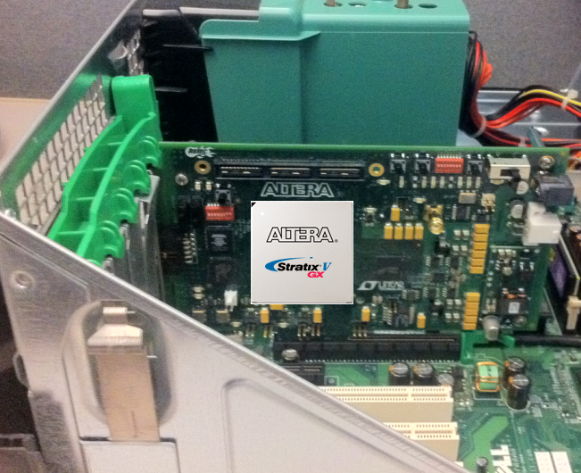
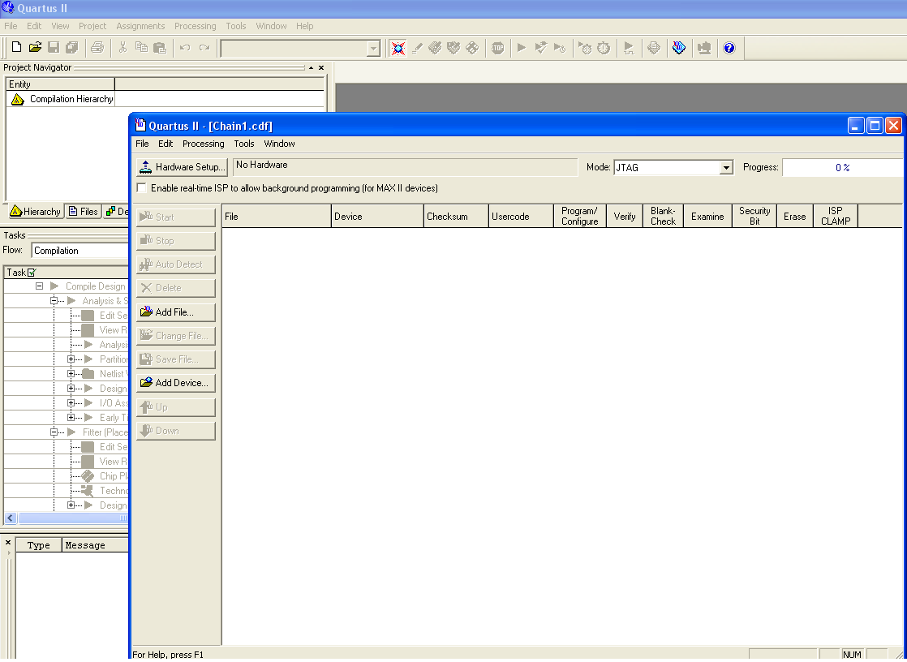
Step 1: Quartus and CvP Initialization
Description: Quartus configures FPGA over PCIe
Benefits:
  Smaller flash device on board
  Host PC doesn’t require a re-start after FPGA is configured
Requirements
  Quartus is able to split a SOF file into two parts
    One configures just the PCIe HIP and Periphery
    One configures the core of the FPGA (everything else)
  Quartus Programmer is able to send a bitstream over PCIe bus
    Requires a new driver being built using the Jungo Toolkit
  Jungo license is required in order for the customer to use this driver
    Except on Altera’s Devkit board
Availability
  11.1
Quartus

Slide 8
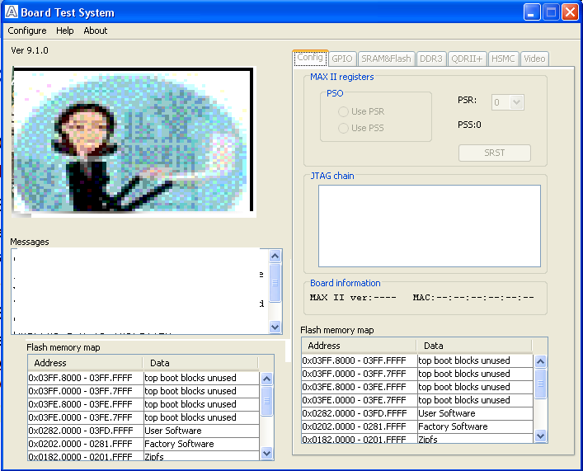
Step 2: Custom Software, CvP Initialization
Description: Custom software can be written to configure the FPGA over PCIe
Benefits:
  Smaller flash device on board
  More secure image storage
  Automated configuration of FPGA upon power-up
Requirements:
  Enable development of customer drivers/software to interface to HIP
    Register map and descriptions
    FPGA Programming Algorithm
Availability
  Beta in 11.1
Custom
Software

Slide 9

Step 3: CvP Update
Description: FPGA core can be re-configured with different core images all matching the same HIP image
Benefits:
  Smaller flash device on board
  More secure image storage
  Automated configuration of FPGA upon power-up
  Software can choose to load different FPGA functionality at will
Requirements:
  New “Partial Reconfiguration” design flow in Quartus
    Users have to be able to create a project that has multiple core images BUT the same HIP/periphery
Availability
  11.1 Beta
  12.0 Production
HIP Image 1
Core
Image 1
HIP Image 1
Core
Image 3
HIP Image 1
Core
Image 4
HIP Image 1
Core
Image 5
HIP Image 1
Core
Image 2

Slide 10
Step 4: Partial Reconfiguration
Description: Portions of the FPGA can be reconfigured with different functionality at will
Benefits:
  Smaller flash device on board
  More secure image storage
  Automated configuration of FPGA upon power-up
  Software can choose to load different FPGA functionality at will…without ever having to completely stop functioning
Requirements:
  Partial Reconfiguration design flow update: Individually reconfigurable blocks
  Enhancements to allow PCIe HIP to update portions of CRAM
    Soft IP to bridge from PCIe HIP to the Partial Reconfig port of the Control Block
    Megacore for PCIe updated with additional Avalon port (connects to soft bridge)
  Updated (or possibly entirely new) set of instructions for creating the drivers
Availability
  12.1
HIP Image 1
Core
Image 1
HIP Image 1
Core
Image 1
PR Block 2
PR Block 1
HIP Image 1
Core Image 1
PR Block 3

Slide 11
Benefits of CvP using PCIe
Lowers system cost
  FPGA programming files stored in a CPU memory attached to the FPGA via a PCIe link
  Reduce the amount of parallel flash devices and possibly an external programming controllers
Smaller board space
  Parallel flash devices can be replaced by a single, serial SPI flash device
Reduces dedicated FPGA configuration pins
  Stratix class devices require one or multiple flash devices to store the FPGA programming file.
No-host CPU stall or re-boot is needed following fabric image updates
  The FPGA operates in the user mode→ CvPCIe is just another software application that the CPU can execute
Protects user application image
  Image copies are accessible only to the host CPU and can be encrypted and / or compressed.

Slide 12
CvP using PCIe Configuration Modes
Mode | Configuration Methods and Speed |  |  | Fabric Configuration Method
 | PCIe Link Speed | PCIe Link used for Config | Initial Full Chip Initialization Required
1 | Gen1, Gen2, Gen3** | N | N | CvP is off (Stratix IV GX Compatible)
2 (CvP Init) | Gen1, Gen2* | Y | N | CvP initializes full fabric AND can update fabric
3 (CvP Update) | Gen1, Gen2, Gen3** | Y | Y | CvP can ONLY update fabric content
Pending Characterization
** Gen 3 is only supported by the Stratix devices
12
Notes:
There are three different configuration modes for CvPCIe.
Mode 1 is where CvP is not in use – you are using FPP or AS to configure the whole device.
Mode 2 is used with Gen 1 and Gen 2 (pending characterization) is being used in user mode and you want to use CvP with PCIe, this mode allows you to update the fabric also (multi-image).
Mode 3 is likely to be used where you want the User Mode to be a PCIe configuration which isn’t supported for CvP like Gen 3.
Q, Why is Gen 3 not supported by CvP using PCIe?
A, Because there has to be a small portion of the FPGA fabric used for control of link optimisation setting the pre-emphasis (via a back channel and equalization of the link) this is not included in the HIP (for flexibility) and GEN 3 will not function without it.
The most important thing about mode 3 you need to configure the whole FPGA within the ~100ms needed to move the PCIe core into user mode and start training see tables later..

Slide 13
CvP using PCIe Usage Models
Single Image Load
(CvP Init)
Multi-Image Loads
(CvP Init & Update)
Mode 2
Mode 2
Mode 3
Configure Periphery and HIP through EPCS or EPCQ
Configure Periphery and HIP through EPCS or EPCQ
Configure Entire Device with Standard Configuration
OR
PCIe Link reaches L0 State and PCIe system boots
PCIe Link reaches L0 State and PCIe system boots
Configure Fabric Core through PCIe Link
Configure Fabric Core through PCIe Link
Update Fabric Core through PCIe Link
13
Notes:
There are three different usage models for CvP when using PCIe
The first is a “Single Image Load” where you want to just load one image into the FPGA and do not want to update it. Mode 2
The Second is a “Multi-Image Load” where you want to load one image into the FPGA and you want to update it later. Mode 2
The third is applicable only to Stratix V and is a “Multi-Image Load” where you want to load one image into the FPGA and you may or may not want to update it later, but you would like the PCIe core to run in Gen3 mode, this method is called Mode 3 and requires soft logic in the core to operate so the initial image has to be loaded via FPP x32 (fastest mode)
For information – Mode 1 is not Configuration via Protocol using PCIe.

Slide 14
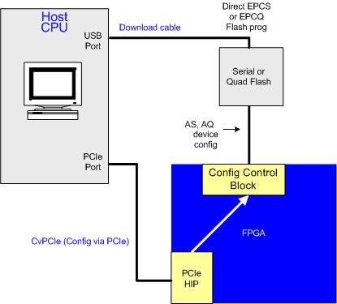
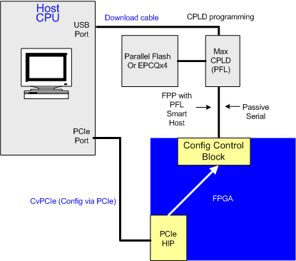
Examples of Configuration Schemes
Direct EPCS
or EPCQ
Flash prog
Download
Cable
Host
CPU
Download
Cable
CPLD
Programming
Host
CPU
USB
Port
USB
Port
Serial or
Quad Flash
Parallel
Flash or
EPCQx4
MAX
CPLD
(PFL)
AS, AQ
Device Config
FPP with
PFL
Smart Host
Passive
Serial
PCle
Port
FPGA
PCIe
Port
Config Control Block
FPGA
Config Control Block
CvP using PCle
(Config via Protocol PCle)
CvP using PCle
(Config via Protocol PCle)
PCle
HIP
PCle
HIP
14
Notes:
This slide shows the methods of configuring 28nm FPGAs all methods can load the HIP and I/O POF for CvP using PCIe.

Slide 15
Examples of CvP Using PCIe Topologies
CPU
CPU
Memory
Root Complex
Root Complex
Memory
Root Port
Root Port
PCle Link with CvPCle
PCle Switch
FPGA #1
Endpoint
Altera EPCS or
EPCQ Flash
Parallel Bus
PCle link 1
with CvPCle
PCle link N
with CvPCle
PCle link N-1
with CvPCle
FPGA #2
FPGA #1
Endpoint
Endpoint
FPGA #(N-1)
Endpoint
FPGA #N
Altera EPCS
or EPCQ #1
Altera EPCS
or EPCQ #N
FPGA #N
Altera EPCS
or EPCQ #(N-1)
1. Switch based hierarchy
2. Cascaded hierarchy
15
Notes:
Because PCIe topologies can be many and varied CvP using PCIe needs to be able to cope with different topologies, the PCIe vendor specific extensions have the ability to describe each FPGA socket in a system so that all topologies can be configured with the correct image.
Cascaded Hierarchy is an opportunistic feature with a user designed interface from the application layer of user mode FPGA #1 to pass on configuration data to other FPGAs via a parallel interface using FPP type interfaces.

Slide 16
Periphery & HIP Configuration Times
Periphery Configuration Mode (Step 1) | Frequency | Periphery Time
FPP x32 | 100 MHz | ~15 msec
FPP x16 | 125 MHz | ~15 msec
FPP x8 | 125 MHz | ~ 17 msec
Active/Passive Serial | 60 MHz | 40-50 msec
Active Quad | 60 MHz | ~25 msec
All configuration modes allow the Periphery and
HIP to configure within the PCIe specification
16
Notes:
The table shows which modes are supported for configuration of the periphery and HIP registers, it gives an idea of the amount of time taken to configure the IO & HIP at maximum configuration speed. All modes support the PCIe startup time for configuration.

Slide 17
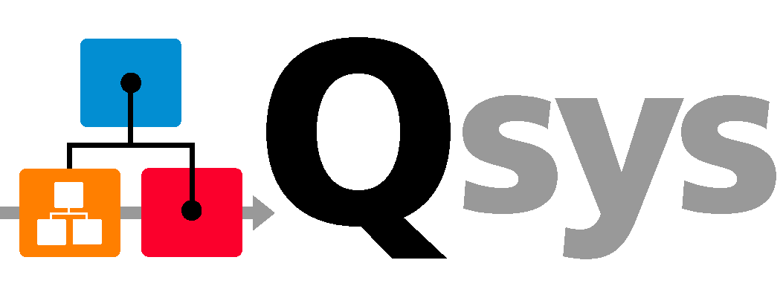
Options for the Interface to User Logic
Avalon Streaming
  Full flexibility to optimize PCIe bandwidth for your application
    Requires understanding of PCIe protocol to decode/encode TLPs
or
Avalon Memory Map
  Simple address and data interface
    Does not require detailed knowledge of PCIe protocol
Both are available for use with the new Qsys system integration tool
Notes:
Now, the Avalon Streaming interface provides access to the full bandwidth available on the PCIe link—however, the application logic behind the hard ip has to perform the tasks of encoding and decoding all of the Transaction Layer Packet. Implementing a design of this sort requires a reasonable understanding of the PCI Express protocol—and even then, it can be quite time consuming to build and test.
Alternatively, you can take advantage of the Avalon Memory Mapped interface which provides a standard interface with simple data, address and control signals.

Slide 18
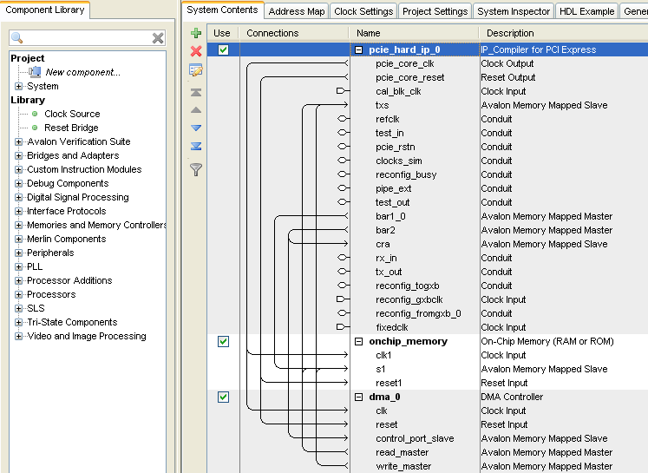

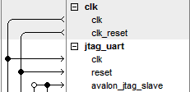
Qsys: Improves Design Productivity
Visual representation of connections between PCIe and other blocks
  Qsys interface shows connections between masters and slaves
Easily add other IP from the design library
  Even save your own IP or subsystems for reuse later
Library of
Available IPs
Enables Connecting IP
and Systems Together
Interface Protocols
Memory
DMA
DSP
Embedded
Bridges
Your Systems
IP 1
IP 2
IP 3
System 1
System 2
Notes:
Qsys is a design tool that basically takes design entry up to a level of abstraction above RTL. The Qsys GUI shows a visual representation of how your system is to be interconnected. You can add IP blocks from Altera’s library of IP from the left hand side there. And you can save your own RTL blocks—or even complete Qsys sub-systems for use within your designs. You choose how to connect the important ports of each block that you add to your system and then Qsys tool generates the interconnect for you.

Slide 19
28-nm HP: Stratix V Specific Innovations
PCIe Gen3
Improved data integrity protection
Extensible architecture

Slide 20
Altera’s PCIe Portfolio
Over five years of developing PCIe solutions
  Soft IP for non-transceiver devices (PIPE interface)
  Soft IP with integrated transceivers for Stratix GX device
  Hardened PCIe IP core in all 40-nm and 28-nm FPGA families
Industry-leading solutions
  Arria II GX FPGA: industry’s first low-cost 40-nm FPGA with hard IP support for PCIe Gen1 x1, x4, and x8
  Stratix IV GX FPGA : industry’s first shipping FPGA solution with hard IP support for PCIe Gen2
  Stratix V GX FPGA: industry’s first FPGA solution with hard IP support for PCIe Gen3
Notes:
That first ever PCIe solution actually had 2 permutations, one that was for FPGAs that did not have transceivers, it required an external transceiver device to interface to the actual pcie bus. The second version allowed for interfacing directly to the pcie bus and was for use with the device families that featured embedded transceivers.
Altera has now hardened PCI express functionality into all of the FPGA devices at both the 40nm and 28nm nodes. A number of industry firsts have realized by these rollouts and with the rollout of the stratix V FPGAs we expects to have the first FPGA capable of demonstrating Gen 3 data rates with a hard IP solution.

Slide 21
First FPGA with Hard IP for Gen 3 Rates!
Number of Lanes | PCIe Speed | User Application Datapath Width (bits) | Min Fabric Clock Rate (MHz) | Notes
1 | Gen 1 | 64 or 72 | 62.5 | Available in both Stratix IV GX and Stratix V
4 |  | 64 or 72 | 125
8 |  | 64 or 72 | 250
 |  | 128 or 144 | 125
1 | Gen 2 | 64 or 72 | 62.5
4 |  | 64 or 72 | 250
 |  | 128 or 144 | 125
8 |  | 128 or 144 | 250
1 | Gen 3 | 64 or 72 | 125 | New in Stratix V
4 |  | 128 or 144 | 250
8 |  | 256 or 288 | 250

Slide 22
Stratix V PCIe Base 3.0 HIP Features
Feature | Stratix V HIP Support
Speed | Gen1, Gen2, Gen3
Lane Configuration | x1, x2, x4, x8
Supported Functions | Endpoint and embedded rootport
PCS Interface | Gen1, Gen2: 8b/10b coding Gen3: 128b/130b coding
Max Payload Size | 2 KB
Embedded Memory Buffers | 16 KB Rx buffer 8 KB replay buffer
Gen3 Equalization | Automatic equalization training
Functions | 1
Virtual Channels | 1
Note: Gen3 and Gen2 support in two speed grades and HardCopy ASICs

Slide 23
Stratix V PCIe Enhanced Reliability
Enhanced data integrity protection
  Improved ECC protection of embedded memory buffers
    Single or multiple adjacent bit-error correction
      Can correct up to 8 adjacent bit errors in memory array
    Double non-adjacent bit-error detection
  ECRC forwarding to / from application layer
  Per byte parity bit protection between LCRC termination point and user logic

Slide 24
S5 HIP Protocol Extension Support (1/3)
Description | Supported | CSEB Required | Config Bypass Required | Notes
Atomic Operations (AtomicOp) | Yes | No | No
Internal Error Reporting | Yes | No | No
Resizable BAR | Yes | Yes | No | Use CSEB extension feature to create the resizable BAR capability, and then use HIP DPRIO to actually change the BAR size
Multicast | Yes | Yes | Yes | Requires config bypass for full support. Without config bypass can be target of multicast if upstream handles multi-cast routing
24
Notes:
24

Slide 25
S5 HIP Protocol Extension Support (2/3)
Description | Supported | CSEB Required | Config Bypass Required | Notes
ID-Based Ordering (IDO) | Partial | No | No | New type of relaxed ordering semantics to improve performance. RX Buffer does not support ID Base re-ordering; HIP will allow TLPs with IDO attribute set for re-ordering elsewhere in the hierarchy;
Dynamic Power Allocation (DPA) | Partial | Yes | No | Dynamic power mgmt for substates of D0 (active state). Requires DPA Capability in soft logic
Latency Tolerance Reporting (LTR) | Yes | Yes | No | Endpoints report service latency requirements, enabling improved platform power mgmt. Requires LTR Capability in soft logic
ASPM Optional (L0s) | Yes | No | No
25
Notes:
25

Slide 26
S5 HIP Protocol Extensions Support (3/3)
Description | Supported | CSEB Required | Config Bypass Required | Notes
Extended Tag Enable Default | Yes | No | No | Support 64 Tag as default
TLP Processing Hints (TPH) | Partial | Yes | No | Re-use Reserved header words, PH, TH and steering tags (lower 8 bits only), requires the use of CSEB for extra capability register. Upper 8-bits of steering tag require TLP prefix (not supported)
TLP Prefix | No | No | No | Mechanism to extend TLP headers in MR-IOV. Requires new physical layer framing. Users implement whole protocol stack in soft IP.
Optimized Buffer Flush/Fill (OBFF) | No | No | No | Requires wake side band signal
26
Notes:
26

Slide 27
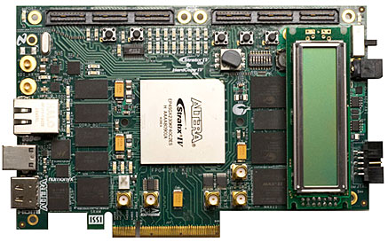
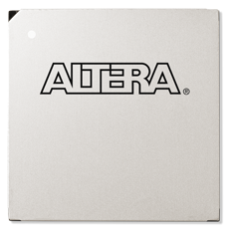

Stratix V GX PCIe Development Kits
Similar to Stratix IV GX development Kit
Stratix V GX A7 in F1517
  PCIe Form Factor
  DDR3 Memory (x72, devices)
  QDRII Memory (2 x18 devices)
  2 HSMCs
  2 SMAs
  BNC or SMB for SDI (in and out)
  QSFP (cable solution to SFP+)
  Display Port
Configuration via
  EPCQ and CvPCIe (Mode 2)*
    Drivers and Ref Design
  x32 and x16 FPP (Mode 3)*
Preliminary!
*See multiple image flow
27
Notes:
This is a preliminary list of features for the Stratix V Development kit, it will be the target for reference designs and drivers for CvPCIe. In all modes.

Slide 28
Arria V and Cyclone V Specific Innovations
Multifuntion

Slide 29


Arria V and Cyclone V: PCIe Multifunction
Arria V FPGA serves as custom I/O hub for PCIe-linked embedded processor
Simplifies sharing of PCIe link bandwidth between attached peripherals of differing types
  Shortens development time by enabling use of standard software drivers
  Each peripheral type handled as its own function
Reduces costs by integrating multiple single-function endpoints into single-multifunction endpoint
  Supports up to eight functions
Processor
Root
Complex
Local Periph1
Memory
Controller
Local Periph 2
PCIe Root Port
PCIe Link
PCIe Endpoint
Multifunction
CAN
USB
GbE
ATA
SPI
Bridge to PCI
GPIO
I2C
Customize Industry-Standard Processors for Your Application
29
Notes:
29

